Slide 1
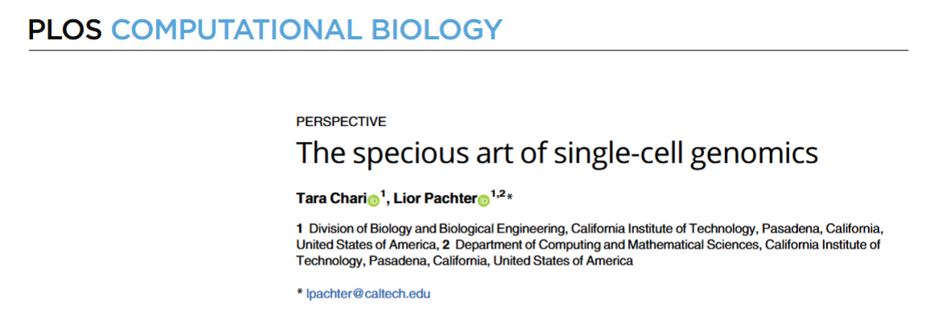
CPBS 7602
Journal Club
December 9, 2024

Slide 2
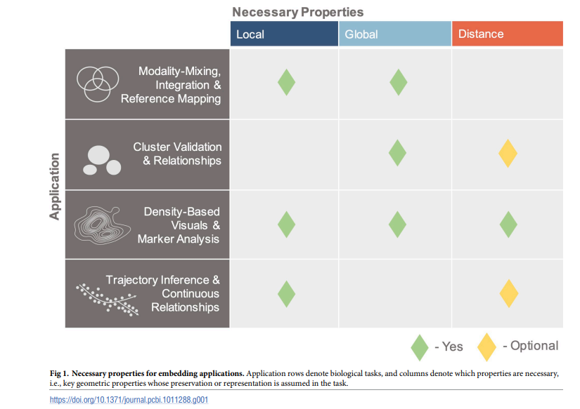
Single-cell Genomics Data Reduction
Goal is to assess these data reduction to see if they 1. preserve column properties
And then 2. impact of this across the row.

Slide 3
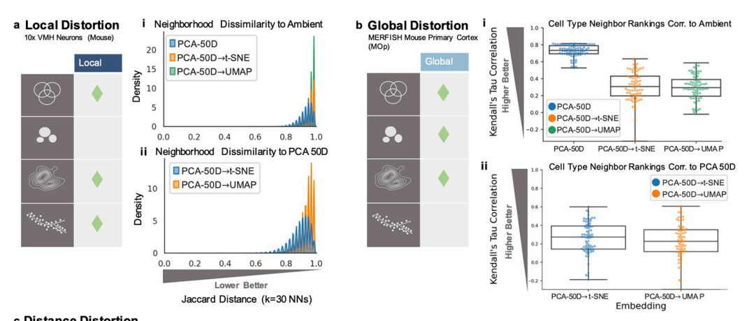
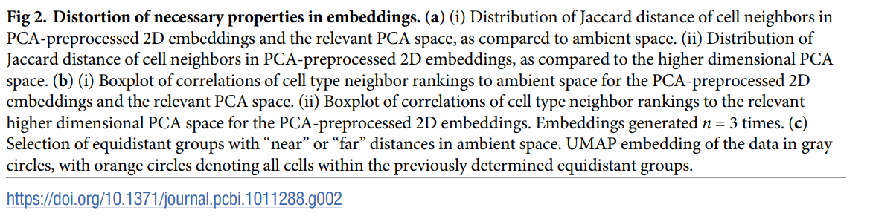

Slide 4
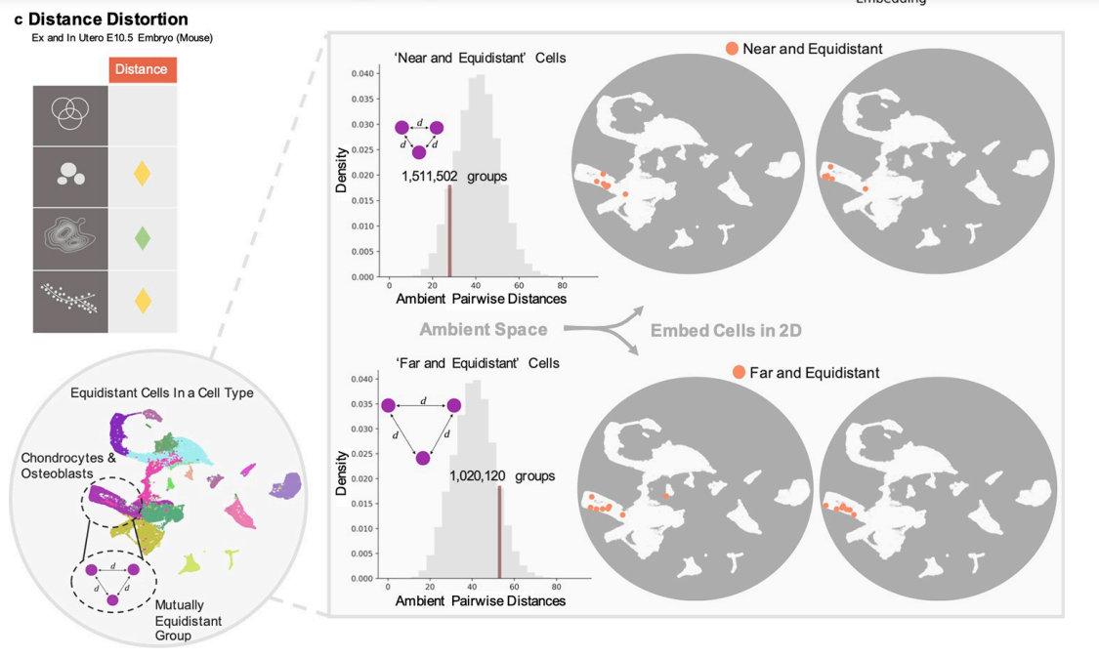

Slide 5
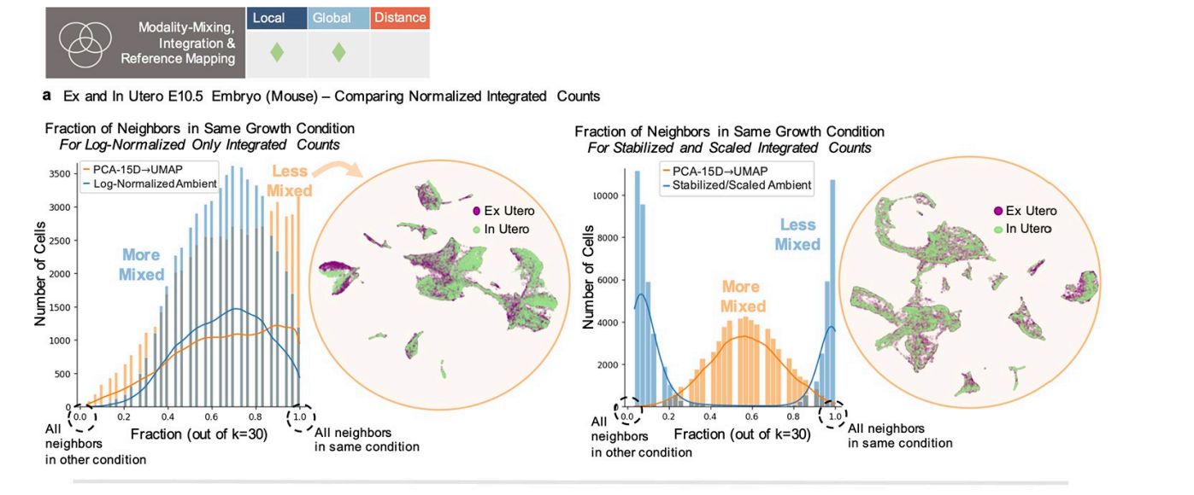
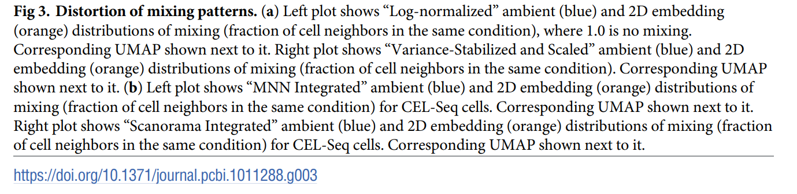

Slide 6
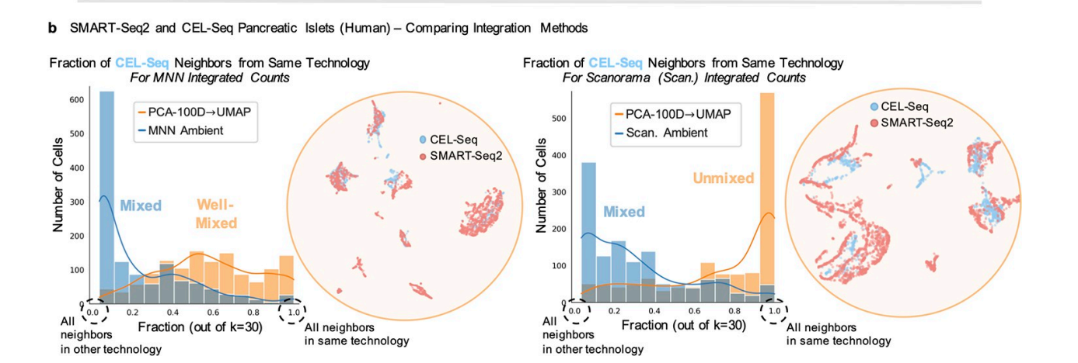

Slide 7
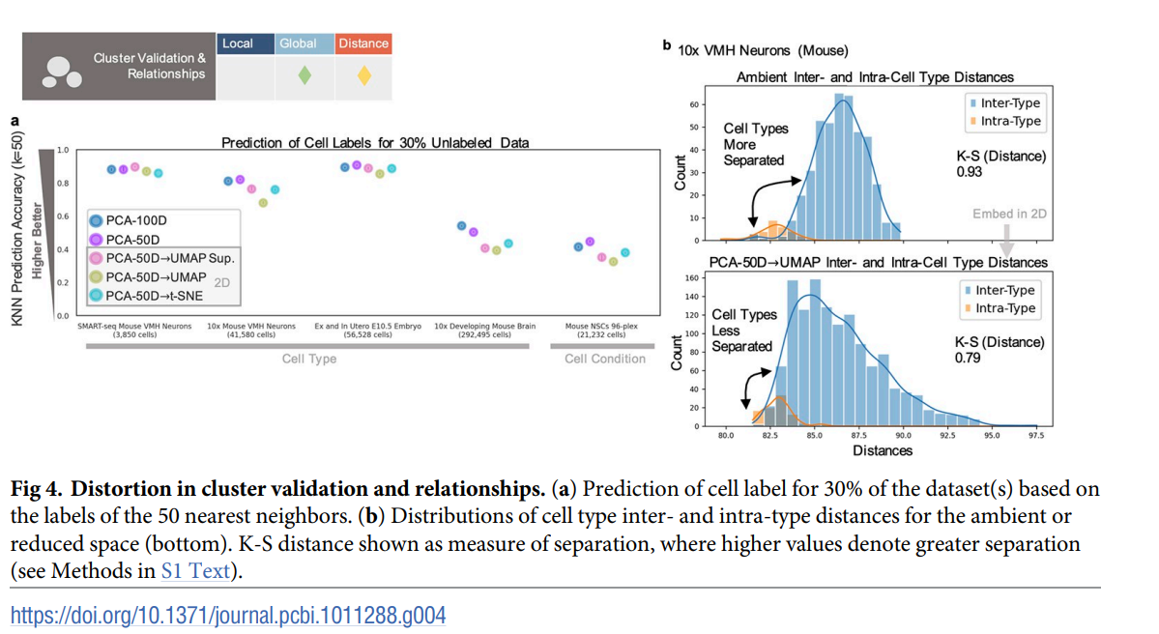

Slide 8
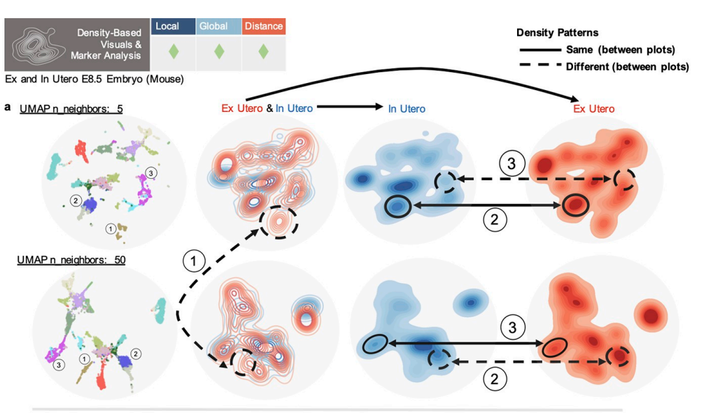
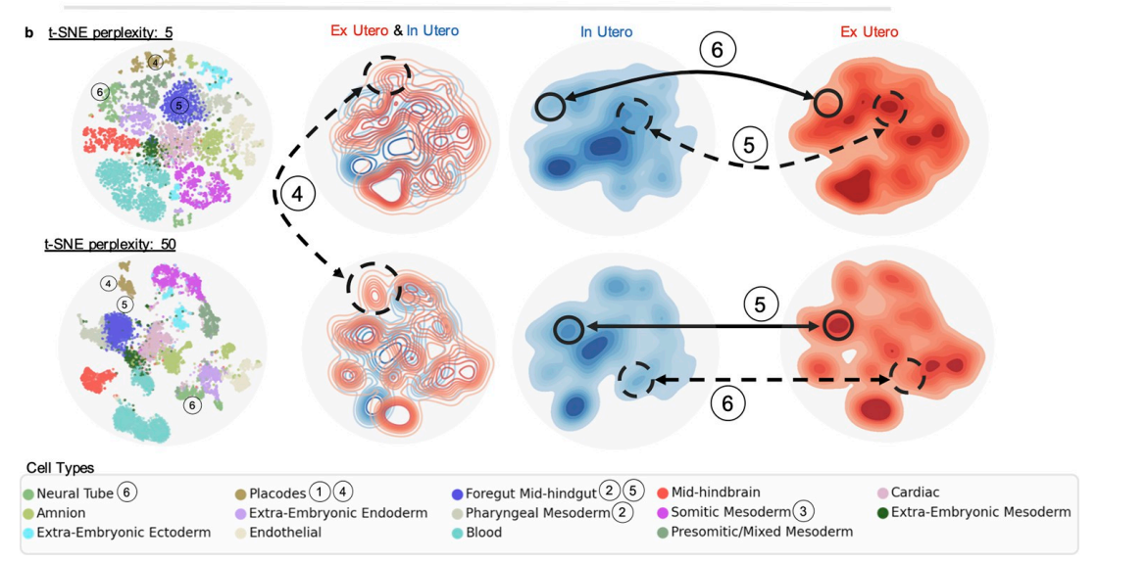
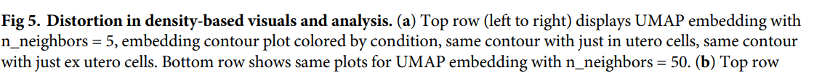

Slide 9
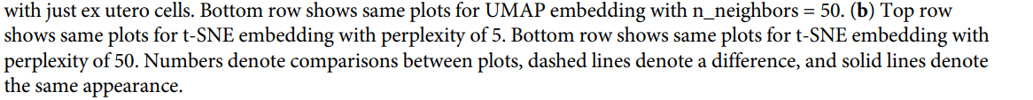

Slide 10
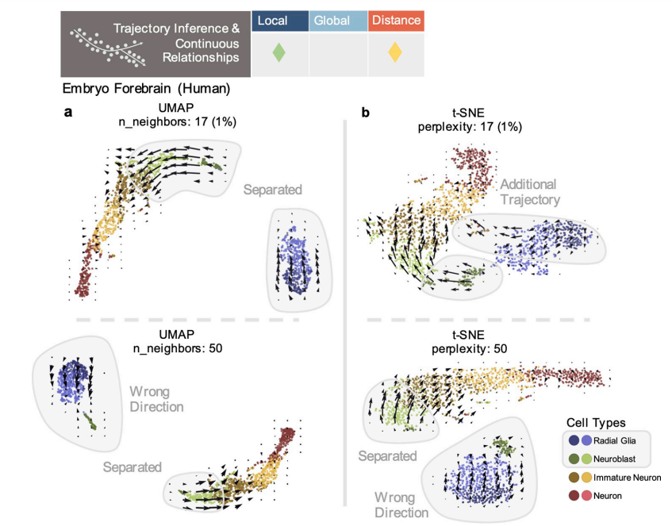
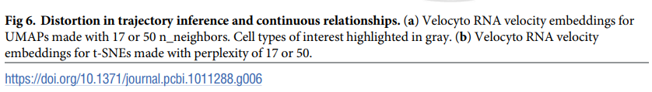

Slide 11
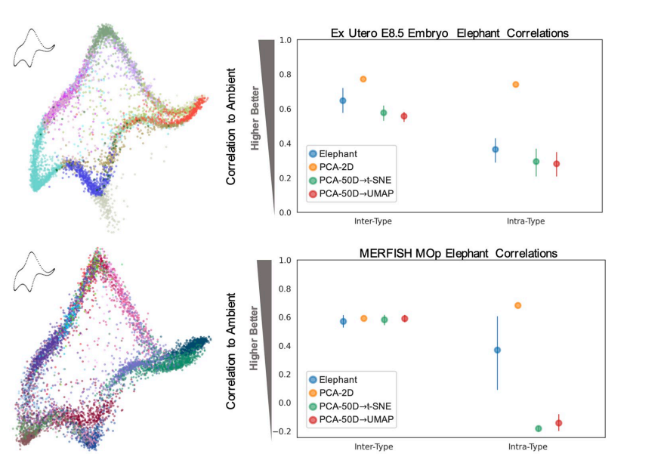
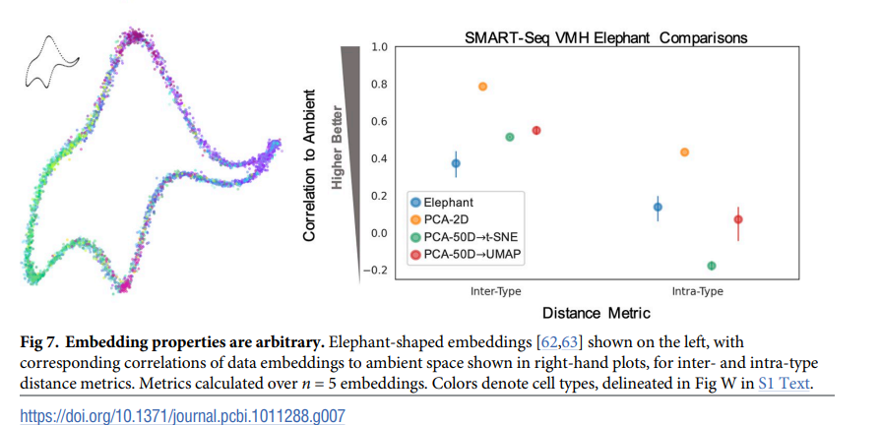

Slide 12
Discussion Take-aways
Key Limitations of 2D Embeddings:
High-dimensional reduction introduces distortions and arbitrary patterns, complicating interpretation.
Parameter tuning and preprocessing (e.g., PCA) confound analysis of data and method properties.
Embeddings often prioritize summary over exploratory analysis, risking confirmatory bias.
Challenges with Current Assumptions:
Default metrics (e.g., Euclidean distance) may not align with biological data structures.
Noise and assumptions in PCA and nonlinear methods (e.g., UMAP, t-SNE) can obscure biological signals.
Recommended Alternatives:
Use targeted metrics and methods tailored to specific biological questions (e.g., clustering, trajectory inference).
Favor high-dimensional analyses and visuals that retain key features (e.g., dendrograms, graph-based diagrams).
Minimize ad hoc transformations and focus on hypothesis-driven, interpretable analyses.
Guidance for Visuals:
Treat 2D embeddings as conceptual post-analysis diagrams, not exploratory tools.
Design visuals to align with analysis objectives, preserving critical data relationships.

